Slide 1
THEORY OF COMPUTATION
CSC-251
Normal Forms
DWIT
sbajracharya@deerwalk.edu.np
9841594548

Slide 2
Chomsky normal form
A CFG is in Chomsky normal form if every rule is of the form:
A BC
A a
Where,
    a is a terminal,
    A,B,C are nonterminals,
    and B,C may not be the start variable

Slide 3
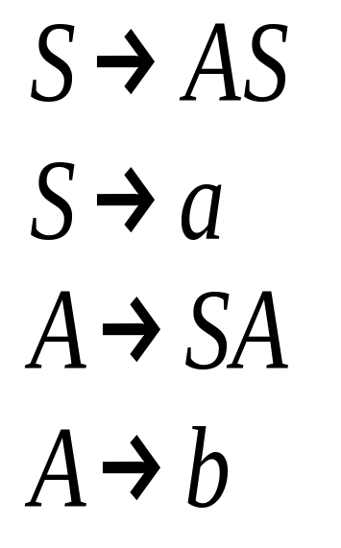
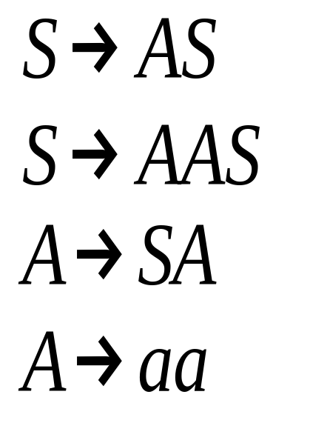
Chomsky normal form
Chomsky
Normal Form
Not Chomsky
Normal Form

Slide 4
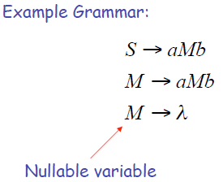
Removing Nullable Variables

Slide 5
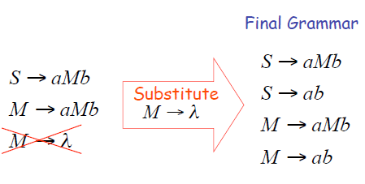
Removing Nullable Variables

Slide 6
Conversion of CFG to CNF
1. Eliminate ε Productions
For example, if P → AxB with both A and B
nullable, add productions P → xB | Ax | x
2. Eliminate Variable Unit Productions
A unit production is where RHS has only one
symbol.
3. Replace Long Productions by Shorter Ones
For example, if production A → BCD, then
replace it with A → BE and E → CD
4. Move Terminals to Unit Productions
For example, replace production A → bC with
productions A → BC and B → b

Slide 7
Conversion of CFG to CNF
Consider the CFG:
S → aXbX
X → aY | bY | ε
Y →X|c
Step 1: Eliminate ε Productions
S → aXbX | abX | aXb | ab
X → aY | bY | a | b
Y →X|c

Slide 8
Conversion of CFG to CNF
Step 2: Eliminate Variable Unit Productions
After elimination of the unit production
Y → X, we obtain:
S → aXbX | abX | aXb | ab
X → aY | bY | a | b
Y → aY | bY | a | b | c

Slide 9
Conversion of CFG to CNF
Step 3 and 4:
Now, break up the RHSs of S; and replace a by A,
b by B and c by C wherever not units:
S → EF | AF | EB | AB
X → AY | BY | a | b
Y → AY | BY | a | b | c
E → AX
F → BX
A→a
B→b
C→c

Slide 10
Convert the following CFG into Chomsky Normal Form:
Classwork
1. S → AbA
A → Aa | ε

Slide 11
Convert the following CFG into Chomsky Normal Form:
Solution
1. S → AbA
A → Aa | ε
Step 1:
S → AbA | bA | Ab | b
A → Aa | a
Step 2 not required.

Slide 12
Convert the following CFG into Chomsky Normal Form:
S → AbA | bA | Ab | b
A → Aa | a
Step 3:
S → TA | bA | Ab | b
A → Aa | a
T → Ab

Slide 13
Convert the following CFG into Chomsky Normal Form:
S → TA | bA | Ab | b
A → Aa | a
T → Ab
Step 4:
S → TA | BA | AB | b
A → AC | a
T → AB
B → b
C → a

Slide 14
Convert the following CFG into Chomsky Normal Form:
1. S→ bA
A → bAA | a
2. S →ASA | aB
A →B | S
B →b | ε
3. S → ABC B →bB | b
A →C | aA C →cCd | c

Slide 15
Convert the following CFG into Chomsky Normal Form:
4. S→ aX | Yb
X →S | ε
Y → bY | b
5. S → aXbX
X → aY | bY | ε
Y → X | c

Slide 16
Greibach Normal Form
A context free grammar is said to be in Greibach Normal Form if all productions are in the following form:
A → αX
A is a non terminal symbols
α is a terminal symbol
X is a sequence of non terminal symbols or
It may be empty.
Or
X→ a β, where a ∈ Σ and β ∈ (V - Σ)*.
May 27, 2009

Slide 17
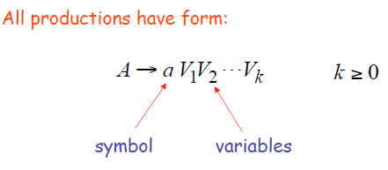
Greibach Normal Form
May 27, 2009

Slide 18
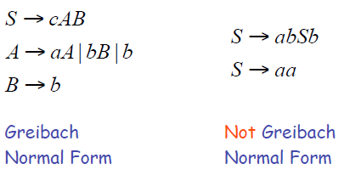
NOT Greibach Normal Form
May 27, 2009

Slide 19
GNF or not??????
1. S → aAB | bBAC
A → a in GNF
B → b
C → c C
A → aBCa
B → cAa not in GNF
May 27, 2009

Slide 20
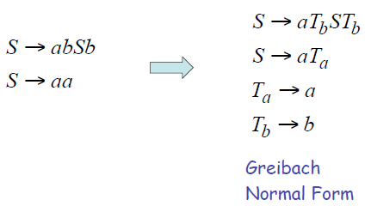
Conversion to GNF
May 27, 2009

Slide 21
Conversion of CFG to GNF
Convert CFG to CNF
Eliminate direct left recursion
Convert rest to proper GNF form
May 27, 2009

Slide 22
Eliminate direct left recursion
Before
  A → Aa | b
After
  A → bZ | b
  Z → aZ | a
Remove the rule with direct left recursion, and create a new one with recursion on the right
May 27, 2009

Slide 23
Eliminate direct left recursion
Before
  A → Aa | Ab | b | c
After
  A → bZ | cZ | b | c
  Z → aZ | bZ | a | b
Remove the rules with direct left recursion, and create new ones with recursion on the right
May 27, 2009

Slide 24
Eliminate direct left recursion
Before
  A → AB | BA | a
  B → b | c
After
  A → BAZ | aZ | BA | a
  Z → BZ | B
  B → b | c
May 27, 2009

Slide 25
CFG to GNF
Step 1: G must be in CNF
Step 2:
If j>i, condition satisfied
If j=i, left recursion (remove it using B_{m})
Make B_{m} also in GNF using substitution rule
A_{i} → A_{j}X_{k} , j > i
Or
A_{i} → aX_{k}
X_{k} is a string of zero
or more variables
May 27, 2009

Slide 26
CFG to GNF: Problem
S → XA | BB
B → b | SB
X → b
A → a
S = A₁
X = A₂
A = A₃
B = A₄
A₁ → A₂A₃ | A₄A₄
A₄ → b | A₁A₄
A₂ → b
A₃ → a
CNF
New Labels
Updated CNF
May 27, 2009

Slide 27
CFG to GNF: Example
A₁ → A₂A₃ | A₄A₄
A₄ → b | A₁A₄
A₂ → b
A₃ → a
First Step
A_{i} → A_{j}X_{k} j > i
X_{k} is a string of zero
or more variables
A₄ → A₁A₄
Not in GNF
May 27, 2009

Slide 28
CFG to GNF: Using substitution Rule
A₁ → A₂A₃ | A₄A₄
A₄ → b | A₁A₄
A₂ → b
A₃ → a
For, A₄ → A₁A₄ we can write,
A₄ → A₂A₃A₄ | A₄A₄A₄ | b
A₄ → bA₃A₄ | A₄A₄A₄ | b
_{So,}
A₁ → A₂A₃ | A₄A₄
A₄ → bA₃A₄ | A₄A₄A₄ | b
A₂ → b
A₃ → a
May 27, 2009

Slide 29
CFG to GNF: Example
A₁ → A₂A₃ | A₄A₄
A₄ → bA₃A₄ | A₄A₄A₄ | b
A₂ → b
A₃ → a
Second Step
Eliminate Left Recursions
A₄ → A₄A₄A₄

Slide 30
CFG to GNF: Example
Example:
Second Step
A₁ → A₂A₃ | A₄A₄
A₄ → bA₃A₄ | A₄A₄A₄ | b
A₂ → b
A₃ → a
Eliminate Left Recursions
A₄ → bA₃A₄ | b
| bA₃A₄Z | bZ | b
Z → A₄A₄
| A₄A₄Z

Slide 31
CFG to GNF: Example
A → αX
GNF
A₁ → A₂A₃ | A₄A₄
A₄ → bA₃A₄ | b | bA₃A₄Z | bZ
Z → A₄A₄ | A₄A₄ Z
A₂ → b
A₃ → a

Slide 32
CFG to GNF: Example
A₁ → A₂A₃ | A₄A₄
A₄ → bA₃A₄ | b | bA₃A₄Z | bZ
Z → A₄A₄ | A₄A₄ Z
A₂ → b
A₃ → a
A₁ → bA₃
| bA₃A₄A₄
| bA₄
| bA₃A₄ZA₄
| bZA₄
Z → bA₃A₄A₄ | bA₄ | bA₃A₄ZA₄ | bZA₄ | bA₃A₄A₄ | bA₄ | bA₃A₄ZA₄ | bZA₄

Slide 33
CFG to GNF: Final Solution
A₁ → bA₃ | bA₃A₄A₄ | bA₄ | bA₃A₄ZA₄ | bZA₄
A₄ → bA₃A₄ | b | bA₃A₄Z | bZ
Z → bA₃A₄A₄ | bA₄ | bA₃A₄ZA₄ | bZA₄ | bA₃A₄A₄Z | bA₄Z | bA₃A₄ZA₄Z |bZA₄Z
A₂ → b
A₃ → a

Slide 34
CFG to GNF: Problem
Convert the CFG
G= ({A1, A2, A3},{a, b}, R,A1)
Where
R={A1→A2A3, A2→A3A1|b, A3→A1A2|a}
into Greibach normal form

Slide 35
CFG to GNF: Solution
A3→bA3A2B3|bA3A2|aB3|a
A2→bA3A2B3A1|bA3A2A1|aB3A1|aA1|b
A1→bA3A2B3A1A3|bA3A2A1A3|aB3A1A3|aA1A3|bA3
B3→bA3A2B3A1A3A3A2B3|bA3A2B3A1A3A1A3A3A2
B3→bA3A3A2B3|bA3A3A2|bA3A2A1A3A3A2B3|bA3A2A1A3A3A2
B3→aB3A1A3A3A2B3|aB3A1A3A3A2
B3→aA1A3A3A2B3|aA1A3A3A2

Slide 36
CFG to GNF: Problem No. 2
S → AB
A → BS | a
B → SA | b

